Slide 1
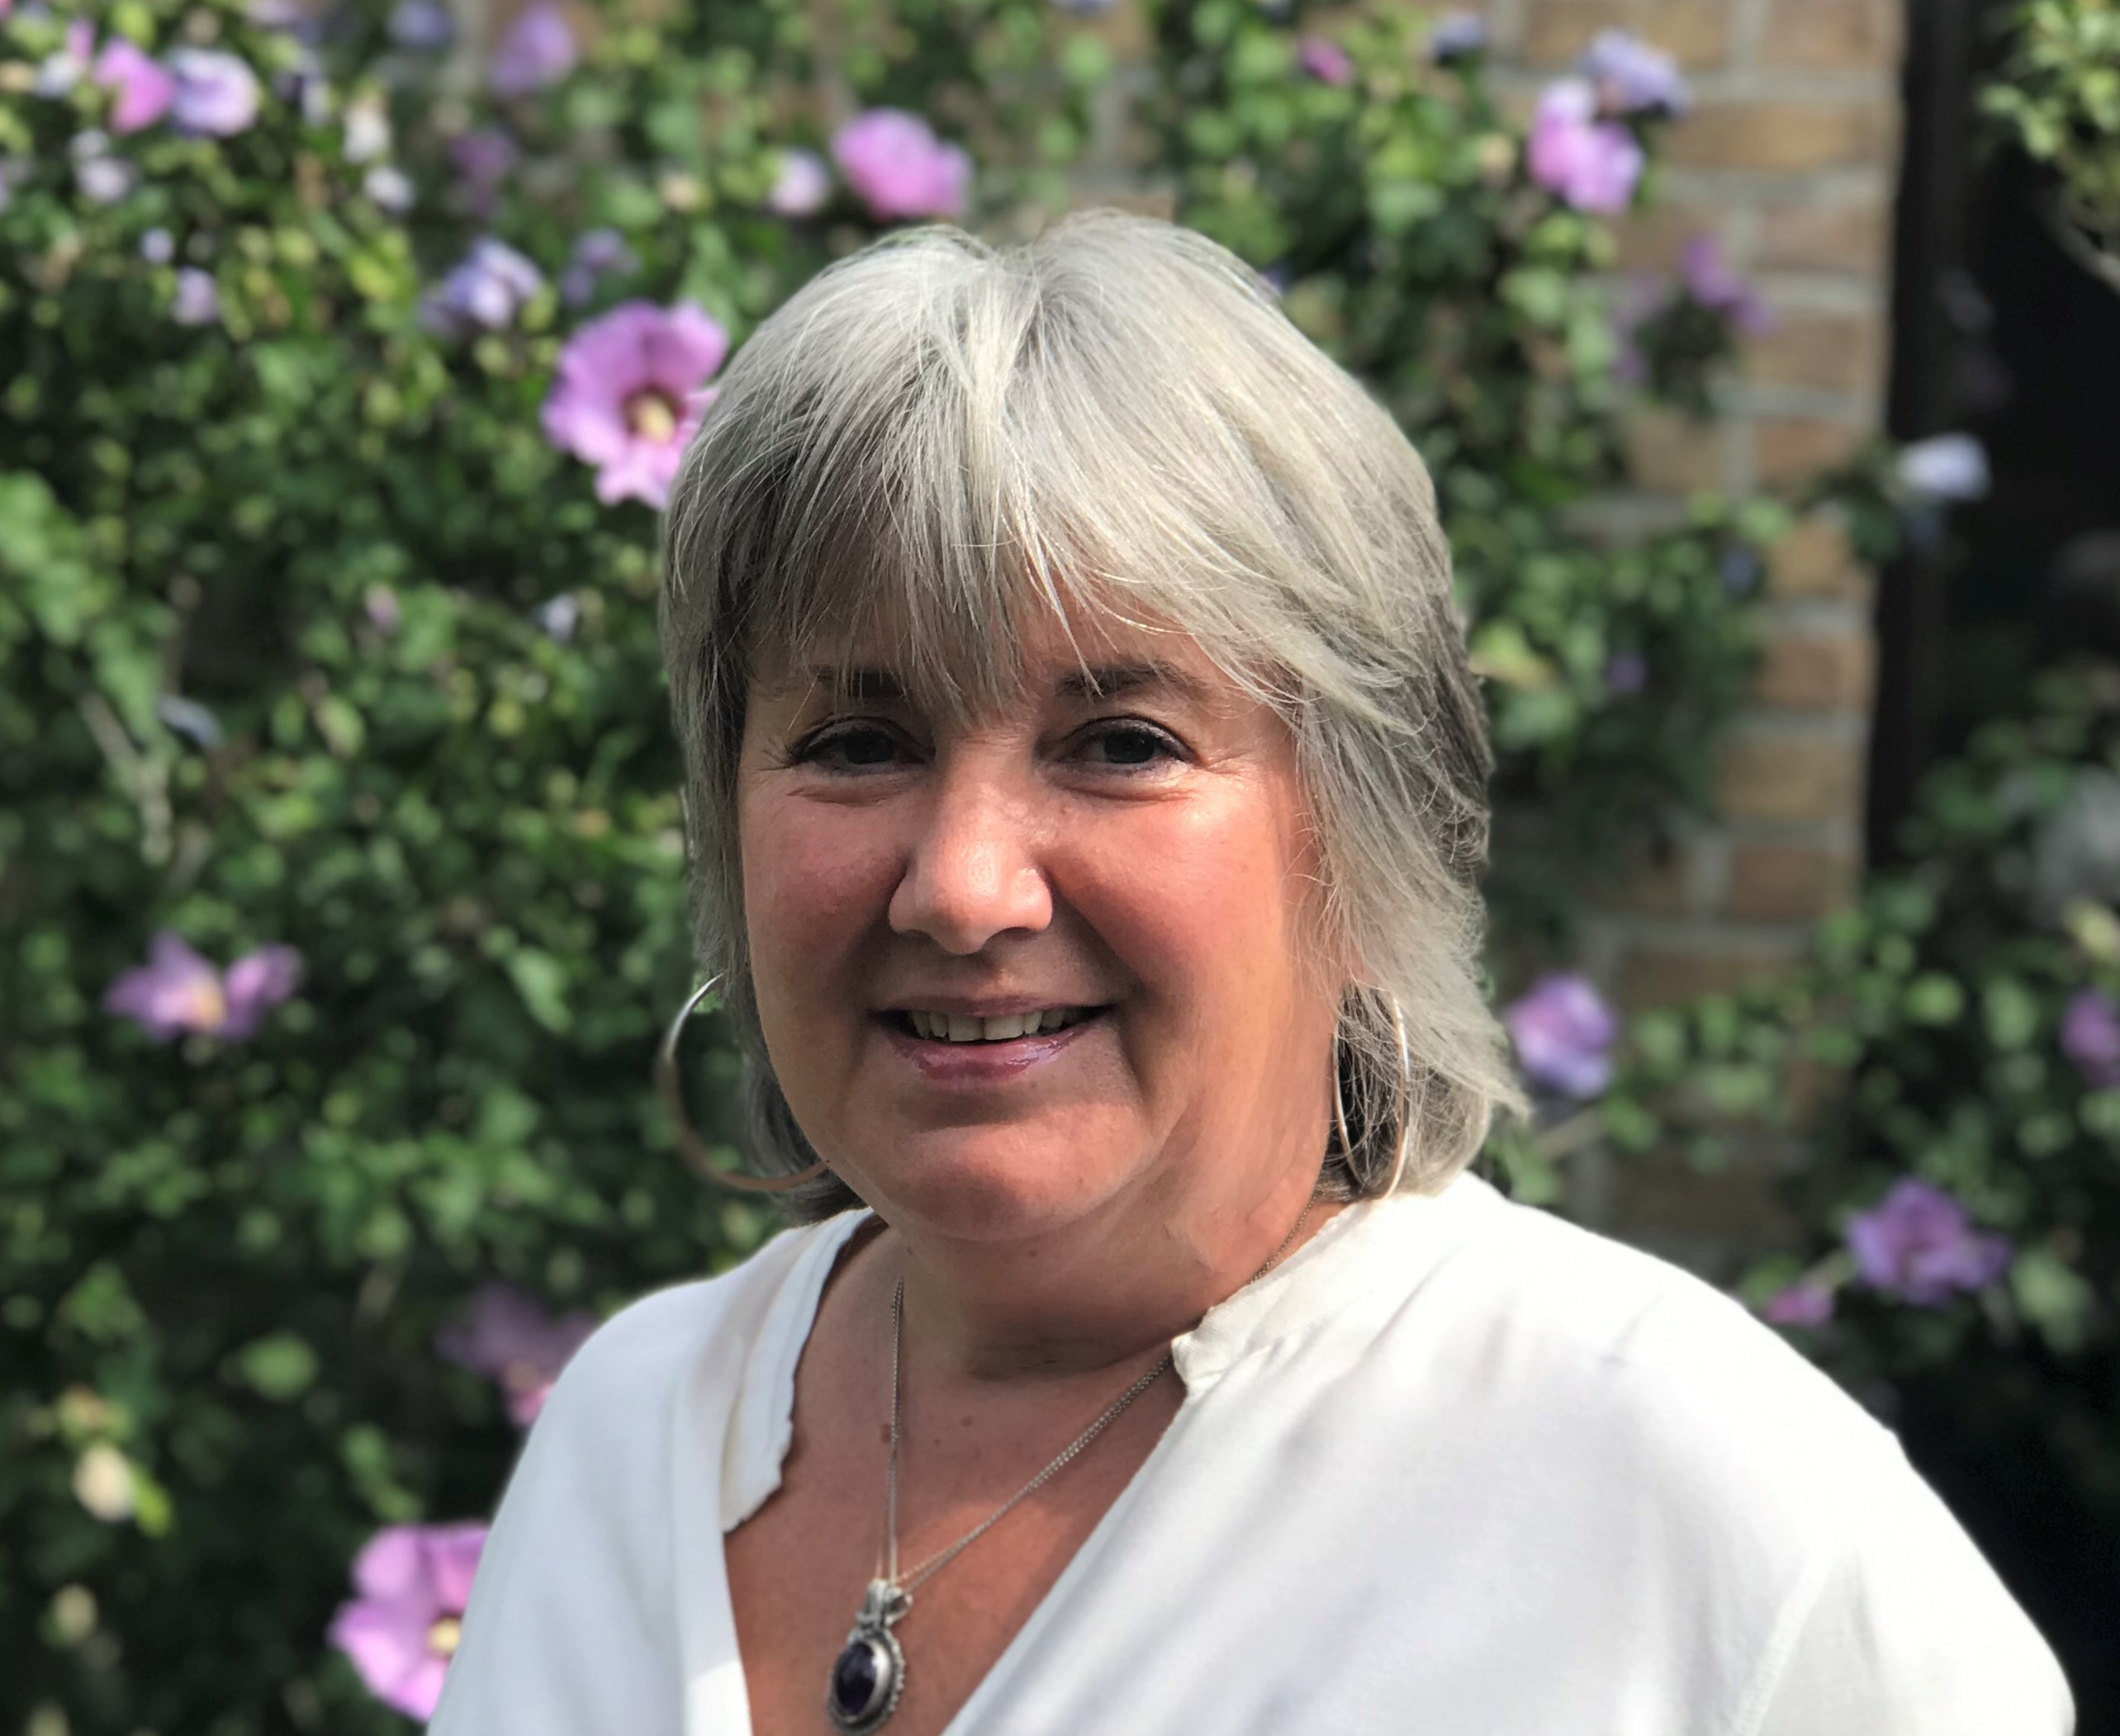
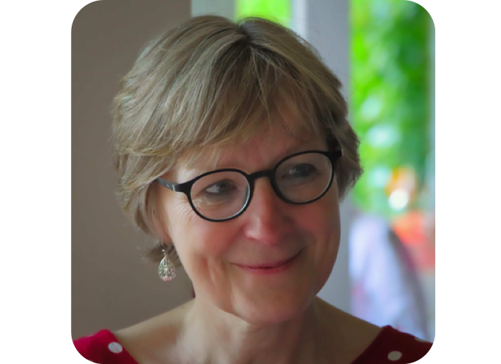
Behavioural workshop
Reading the Energy Field
My presence in facilitation in S3
Anne Anne
Damoiseaux de Beer
November 2020

Slide 2
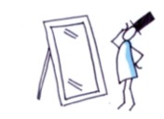
Who am I ?

Slide 3
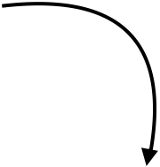
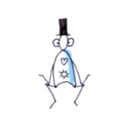
Who am I ?
Mastering my emotional intelligence

Slide 4
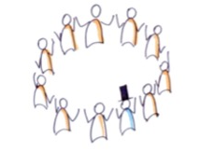
Who am I ?
Mastering my emotional intelligence
Create whole-hearted bonds with the group

Slide 5
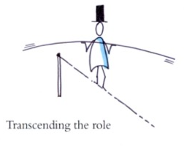
Who am I ?
Mastering my emotional intelligence
Transcending my role
Create whole-hearted bonds with the group

Slide 6
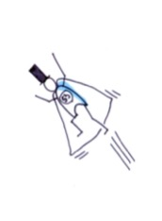
Who am I ?
Mastering my emotional intelligence
Transcending my role
Create whole-hearted bonds with the group

